Slide 1
IPR and Business Strategies for Value Creation
Prof. (Dr.) Mukesh Srivastava
Visiting Professor Project: Intellectual Property Rights and Technology Transfer University of Mauritius | Director, Center for Business Research Prof. of Management Information Systems University of Mary Washington

Slide 2
Workshop
Agenda
09:15- 09:30 Registration
09:30- 09:35 Welcome Note
09:35-09:50 Intellectual Property Rights- An Orientation
09:50-10:15 An assessment of the current IPR Landscape
10:15-10:30 Coffee/Tea Break
10:30-12:00 Group Discussions
12:00-13:00 Lunch
13:00-14:30 Fundamentals of IP
14:30-14:45 Coffee/Tea Break
14:50-15:45 IP & Business Strategies/ Commercialisation

Slide 3
Workshop Introductions

Slide 4
Workshop Objectives

Slide 5
Objectives
Overarching
  Strengthen Knowledge and Understanding of IP AEcosystem
Specifics
  Understand fundamentals of IP
  Provide insights into preparing Patent applications
  Explore the technical and legal information contained in APatent documents
  Understand strategies for IP creation, commercialization Aand monetization

Slide 6
Objectives
Overarching
  Strengthen Knowledge and Understanding of IP Ecosystem
Government
Strengthen IP Ecosystem to support better Innovation and Commercialization space
Future
Develop new initiatives in IP management and value creation
Strategies & Policies
Significantly grow the community of IP and commercialization experts
Economy
Strengthen regional and national capabilities to commercialize

Slide 7
Intellectual Property Rights:
An Orientation
(Handout # 1)
09:35-09:50
 | Patent (e.g. Processes and Devices) | Trademark | Industrial Design | Geographical Indicator | Copyright (e.g. Literary works, films, Music, Artistic works, architectural design, etc.)
Type of Work Protected | Inventions that meet certain requirements (novelty, non-obviousness, usefulness) | Name, symbol, figure, letter, word or mark that identifies goods or services produced. | Ornamental or aesthetic aspects of an article. | Goods that have a specific geographical origin and possess qualities or a reputation due to that place of origin | Forms of expression of ideas
Form of Protection | Formal recognition of rights that exclude unauthorized parties from exploiting an invention in a particular country. | Ensures owners of marks have the exclusive right to use them. | Ensures owners an exclusive right against unauthorized copying or imitation. | A matter of national law and consumer perception. | Excludes unauthorized parties from exploiting a form of expression worldwide.
Timeline | Typically good for 20 years. | Can be renewed indefinitely upon payment of the corresponding fees. | Indefinite | Indefinite | Typically good for 50 years.

Slide 8
An assessment of the current IPR Landscape
(Handout # 2)
09:50-10:15
IP Assessment Tool

Slide 9
An assessment of the current IPR Landscape
(10:15-10:30 )
Coffee/Tea Break
(10:15-10:30 am)

Slide 10
An assessment of the current IPR Landscape
(Handout # 3)
10:30-11:00
Template for Utility Patent Assessment
Template for Design Patent Assessment
Template for Plant Patent Assessment
(Please fill out if applicable)

Slide 11
An assessment of the current IPR Landscape
11.00-12:00
Group Discussions
    Current Innovation Landscape
    Focus Areas
    Strategic Technologies

Slide 12
Lunch Break
(12:00-13:00 )
Lunch
(12:00-13:00 am)

Slide 13
Fundamentals of Intellectual Property
13:00-14:30

Slide 14
Workshop Objectives

Slide 15
Objectives
Overarching
  Strengthen Knowledge and Understanding of IP AEcosystem
Specifics
  Understand fundamentals of IP
  Provide insights into preparing Patent applications
  Explore the technical and legal information contained in APatent documents
  Understand strategies for IP creation, commercialization Aand monetization

Slide 16
Objectives
Overarching
  Strengthen Knowledge and Understanding of IP Ecosystem
Government
Strengthen IP Ecosystem to support better Innovation and Commercialization space
Future
Develop new initiatives in IP management and value creation
Strategies & Policies
Significantly grow the community of IP and commercialization experts
Economy
Strengthen regional and national capabilities to commercialize

Slide 17
Developing a Foundation

Slide 18
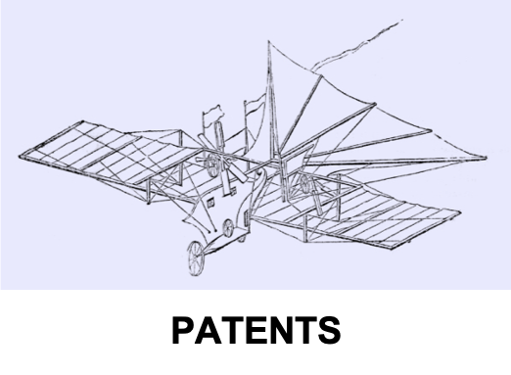

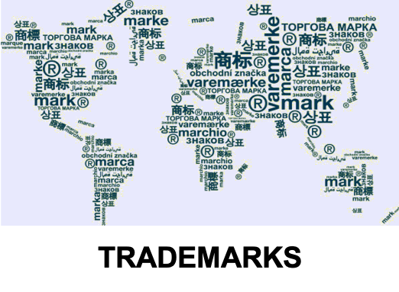

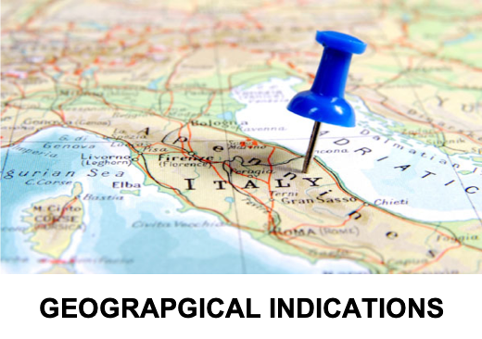
What is Intellectual Property?

Slide 19
What is Intellectual Property?
Intellectual Property refers to creations of the mind:
Inventions
Literary and artistic works
Symbols, names and images used in Acommerce
(Ref: World Intellectual Property Organization Publication 867: http://www.wipo.int/about-ip/en/)

Slide 20
Intellectual Property is divided into 2 categories
Industrial Property includes:
  Patents
  Trademarks
  Industrial designs
  Geographical indications.
Copyright covers
  Literary works (e.g., novels, poems, and plays)
  Films
  Music
  Artistic works (e.g., drawings, paintings, photographs, and sculptures)
  Architectural design.
Rights related to copyright include those of performing artists in their performances, producers of phonograms in their recordings, and broadcasters in their radio and television programs.
(Ref: World Intellectual Property Organization Publication 867: http://www.wipo.int/about-ip/en/)

Slide 21
Industrial Property

Slide 22
What is a Patent?
  An exclusive but limited right granted by the U.S. (or other) government.
  By law excludes others from practicing an invention.
  The claims of a patent define the invention covered by the patent.
  Applies to the first and true inventors of a new, not obvious and useful product or use in exchange for the public disclosure of the invention.
  Lasts for 20 years from filing date

Slide 23
What is a Trademark?
  A distinctive name, symbol, figure, letter, word or mark that identifies goods or services produced or provided by an individual or a company
  Registration and protection ensures that owners of marks have the exclusive right to use them to identify goods or services.
  Helps consumers to identify and purchase a product or service based on whether its specific characteristics and quality meet their needs.
  A trademark can be renewed indefinitely upon payment of the corresponding fees.
  Trademark protection is legally enforced by courts that have the authority to stop trademark infringement.

Slide 24
What is an Industrial Design?
  The ornamental or aesthetic aspects of an article … may consist of three-dimensional features, such as the shape or surface of an article, or two-dimensional features, such as patterns, lines or color.
  Registration and protection ensures an exclusive right and protection against unauthorized copying or imitation of the design by third parties.
  Any technical features of the article to which it is applied are not protected by the design registration (i.e., requires a patent).
  To be protected under most national laws, an industrial design must be new or original and nonfunctional.

Slide 25
What is a Geographical Indicator?
  A sign used on goods that have a specific geographical origin and possess qualities or a reputation due to that place of origin.
  Whether a sign functions as a geographical indication is a matter of national law and consumer perception.
  Most commonly, a geographical indication consists of the name of the place of origin of the goods.
  Agricultural products - typically have qualities that derive from their place of production and are influenced by specific local geographical factors (e.g., climate and soil).
  Other products – typically highlight qualities due to human factors found in the product’s place of origin (e.g., manufacturing skills and traditions)

Slide 26
What is a Copyright?
  Grants authors, artists and other creators protection for their literary and artistic creations, generally referred to as “works”.
  Usually no registration is required, and the copyright of a piece of work is recognized as soon as it is created (typically good for 50 years).
  A closely associated field is “related rights” … beneficiaries of related rights are:
    Performers (such as actors and musicians) in their performances; producers of phonograms (for example, compact discs) in their sound recordings; and broadcasting organizations in their radio and television programs.
  Works covered by copyright include, but are not limited to:
    Novels, poems, plays, reference works, newspapers, advertisements, computer programs, databases, films, musical compositions, choreography, paintings, drawings, photographs, sculpture, architecture, maps and technical drawings.

Slide 27
Importance of Intellectual Property

Slide 28
Why is Intellectual Property Important?
Motivates the creation and invention of new works in the areas of technology and culture.
The legal protection of new creations encourages the commitment of additional resources for further innovation.
The promotion and protection of intellectual property spurs economic growth and creates new jobs and industries.
Strike a balance between the innovator’s interest and the public interest, providing an environment in which creativity and invention can flourish, for the benefit of all.

Slide 29
Benefactors and Values of IP Protection
Inventor(s)/Creator(s)
Exclusive rights and protection of IP Monetary (New Revenue/Income) Self Actualization and Esteem Contribution to Society and Others
Government
Exclusive rights and protection of IP Unlimited government rights Tax Payer Pay Back (e.g. Commercialization, Reduced Costs, etc.)
Businesses/Companies
Protection of IP Protection of Market Share Competitive Advantage Financial (Increased Revenue, Profits and Market Value) New Market Creation Corporate Asset Promotes fair competition Facilitates international trade
Society
Catalysts for economic development Encourages creativity and innovation Introduces new/improved products Creates new markets/industries Creates jobs and increases wages Expands exports of national products Promotes social and cultural advancements Advances Quality of Life

Slide 30
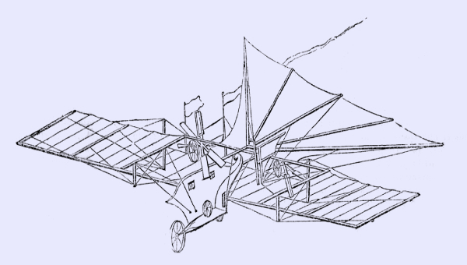
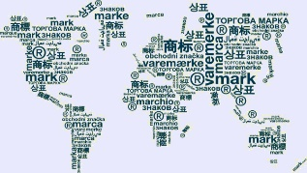
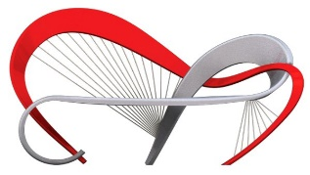
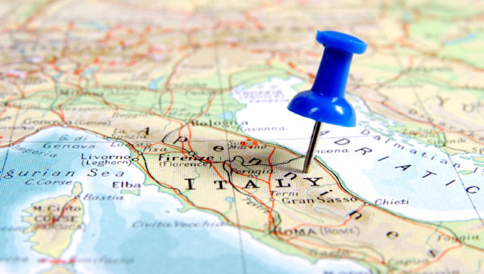
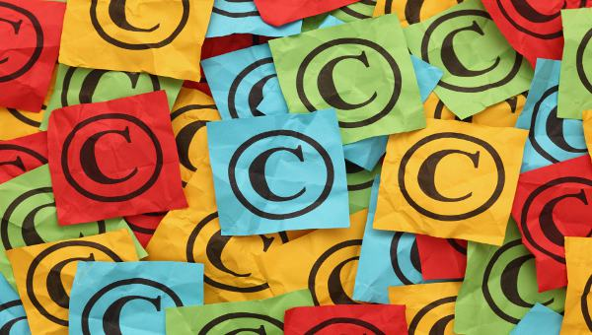
Summary
 | Patent (e.g. Processes and Devices) | Trademark | Industrial Design | Geographical Indicator | Copyright (e.g. Literary works, films, Music, Artistic works, architectural design, etc.)
Type of Work Protected | Inventions that meet certain requirements (novelty, non-obviousness, usefulness) | Name, symbol, figure, letter, word or mark that identifies goods or services produced. | Ornamental or aesthetic aspects of an article. | Goods that have a specific geographical origin and possess qualities or a reputation due to that place of origin | Forms of expression of ideas
Form of Protection | Formal recognition of rights that exclude unauthorized parties from exploiting an invention in a particular country. | Ensures owners of marks have the exclusive right to use them. | Ensures owners an exclusive right against unauthorized copying or imitation. | A matter of national law and consumer perception. | Excludes unauthorized parties from exploiting a form of expression worldwide.
Timeline | Typically good for 20 years. | Can be renewed indefinitely upon payment of the corresponding fees. | Indefinite | Indefinite | Typically good for 50 years.

Slide 31
Questions/Discussions

Slide 32
Coffee Break
(14:30-14:45 )
Coffee Break
(14:30-14:45)

Slide 33
IP and Business Strategies/Commercialisation
IP and Business Strategy
(14:50-15:45 )
(14:50-15:45 )

